Slide 1


Fundamentals of RM
RM System and Process
Leadership in RM
Incident Investigation
RM Tools & Challenges
RM in Industry
People & Org.
Application and Perspectives
On Becoming a
Leader in Risk Management
ENGG404 - Lecture
ENGG404 – Key Excerpts
on Course Expectations
(present before the Add/Drop Date)

Slide 2
Course Syllabus:
When to Take This Course (complete details in the Syllabus):
Are you taking ENGG404 out-of-sequence (i.e. not taking this course per your program / plan / year schedule)?
Think again! Consider these points:
400-Level / 4th year heavily-weighted course: Weighting = 3.8
Team project with your cohort is beneficial; on a work-term is a hindrance!
In-sequence with Program/Plan and Year: Team Project Intent is to work on a team project with specific relevance to your engineering discipline to enhance your learning experience in this course.
On a work term? This course uses blended learning techniques and requires attendance, participation, and engagement in real-time. Your work-term commitments will create conflicts and are barriers to success.
You should NOT take this course out-of-sequence, or as an “add-on” while on your work term.
ENGG404 Expectations, Course Syllabus, Course Plan, and Exam
2
Notes:
2

Slide 3
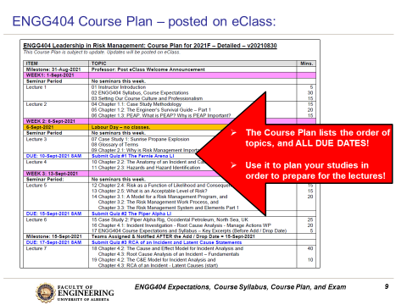
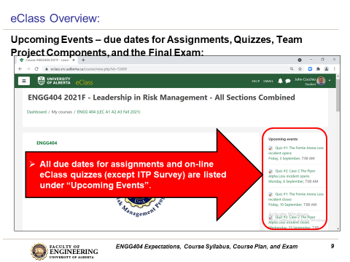
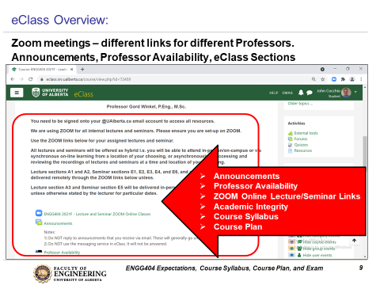
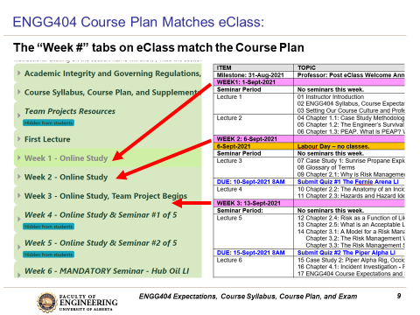
Brief Snap-shots of Expectations:
ENGG404 - Leadership is for All Engineers
3
Notes:
3

Slide 4
This Course is Different – Case Study and Blended Learning!
Key Differences!
Case Study Methodology
No complex formula - any calculations are basic arithmetic.
No absolute right or wrong answer.
Apply sound principles, practices, and rationale of engineering, and leadership in risk management to support your position
Lots of examples to work through in this course
Blended Learning Format:
Requires students to prepare ahead of lectures and seminars
Review lecture PPTs and/or textbook, review videos or readings
Respond to on-line eClass quizzes BEFORE the lectures
Designed to motivate the student to prepare ahead of lectures, NOT assess after lectures
Active Learning Exercises
In-class, designed to engage students and to self-assess (not graded)
ENGG404 Expectations, Course Syllabus, Course Plan, and Exam
4
Notes:
4

Slide 5
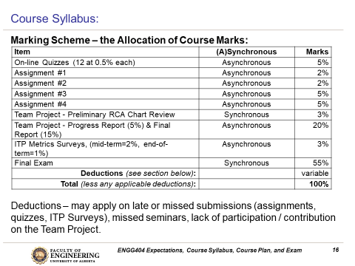
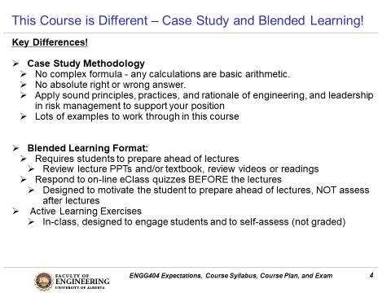
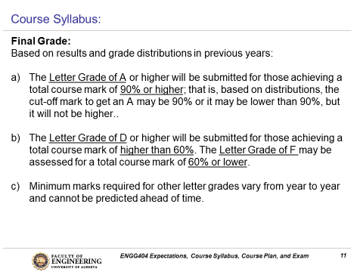
Brief Snap-shots of Expectations:
ENGG404 - Leadership is for All Engineers
5
Notes:
5

Slide 6
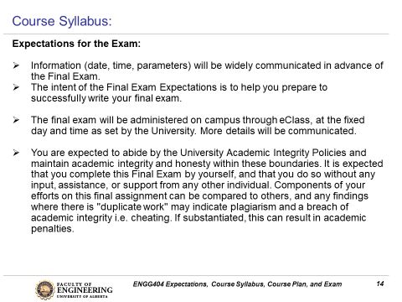
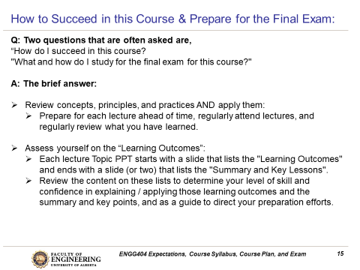
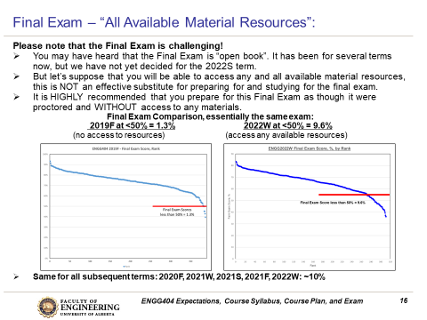
Brief Snap-shots of Expectations:
ENGG404 - Leadership is for All Engineers
6
Notes:
6

Slide 7
Any questions?
Notes:
7

